Slide 1
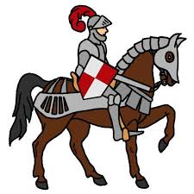
The Tale of the Knight!
Hear ye, hear ye! Travel with the Knight for fun, come and see!

Slide 2
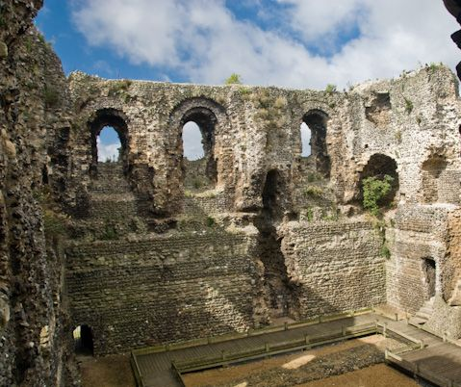
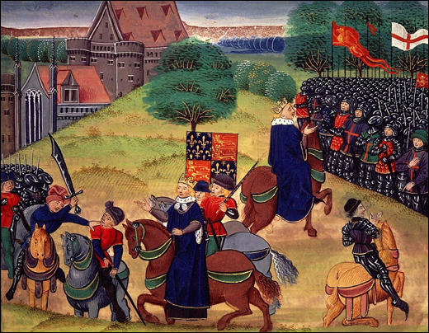
The Knight’s Home!
Canterbury, England
Medieval Period (1066-1485)
Highly influenced by Roman Catholic Church
Feudal System in place
Writings influenced by the French
Tabard Inn

Slide 3
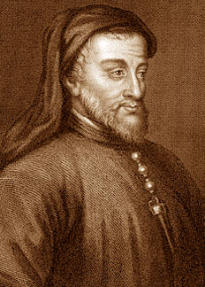
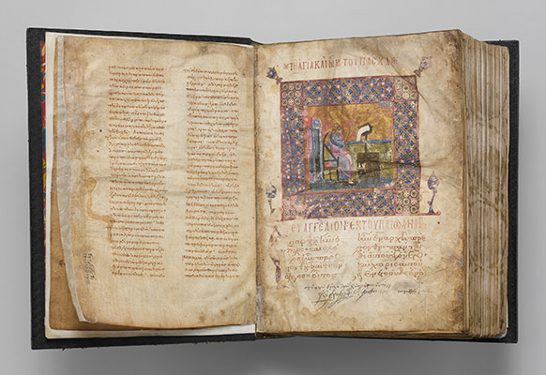
The Knight’s Author!
Geoffrey Chaucer
1340-1400
Began Canterbury Tales around 1387, never finished
Written with satiric style
24 stories in one!

Slide 4
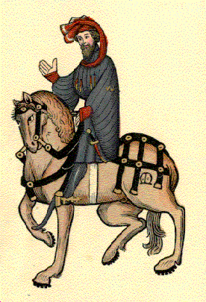
The Knight Himself!
“Followed chivalry, Truth, honor, generousness and courtesy”
“In fifteen mortal battles had he been And jousted for our faith”
“Just home from service, he had joined our ranks To do his pilgrimage and render thanks”
Journeyed with the Squire (his son) and the Yeoman (his companion)
“Speaking of his equipment, he possessed Fine horses, but was not gaily dressed,” “wore a fustian tunic stained and dark With smudges where his armor had left mark”

Slide 5
The Knight’s Comparison!
LeBron James:
Both the Knight and LeBron are very well-known, important difference-makers to their respective places. The Knight has battled more than fifteen times, while LeBron has played in eight NBA Finals appearances. They both strive for the greater good of the people around them, and share many of the same qualities: courtesy, generousness, truth, etc. Also, while holding such fame, neither wears extreme clothing to get attention. And, they’re both really tall, strong dudes!

Slide 6
The Knight’s Pitch!
Though you may be unneeded for my journeys, I will bring safety, battle with caution, and strive for victory night and day. However, an extra pack of clothing may be of use to you, as I do not wash my own very often, a trait that may kill me in the end. Air freshener may also be of need. Huzzah!

